Slide 1
Media Arts!

Slide 2
What is Media Arts?
Artwork dependant on and made from technology
It began as early as the 1800s with the emergence of photography
This includes:
Computer animation
Digital art
Video games
3D printing
Etc.

Slide 3
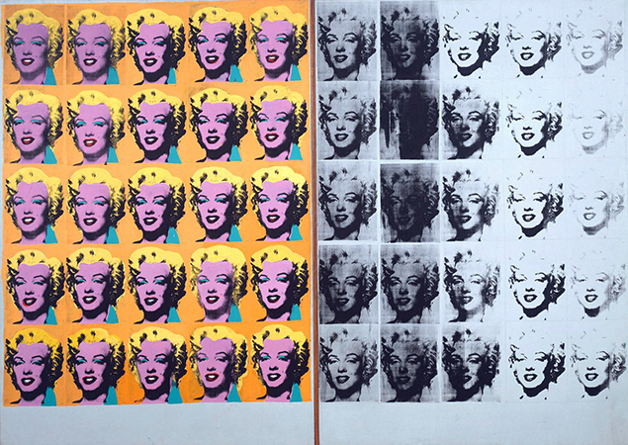
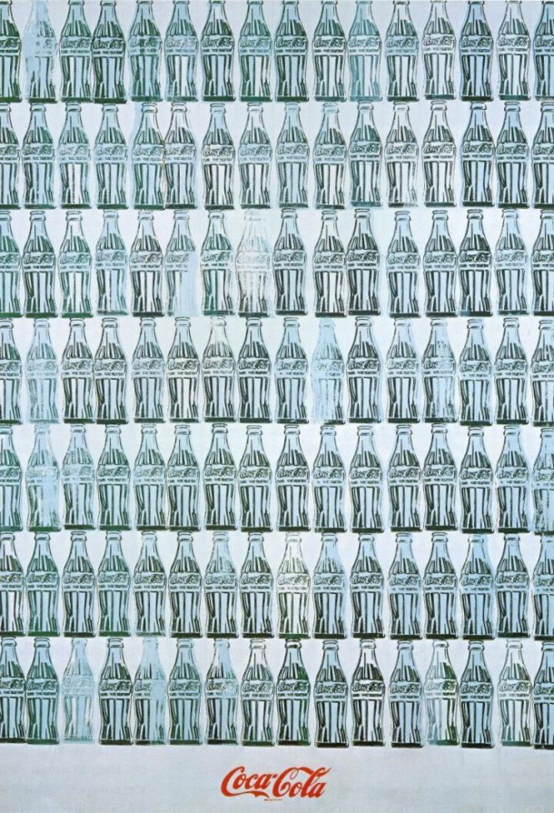
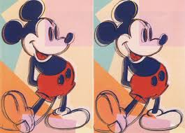
Andy Warhol
A famous Media Arts artist who was part of the pop art movement.
The pop art movement was grounded in consumer culture and mass media.
Warhol used screen printed images, film, and paint to create his art.

Slide 4



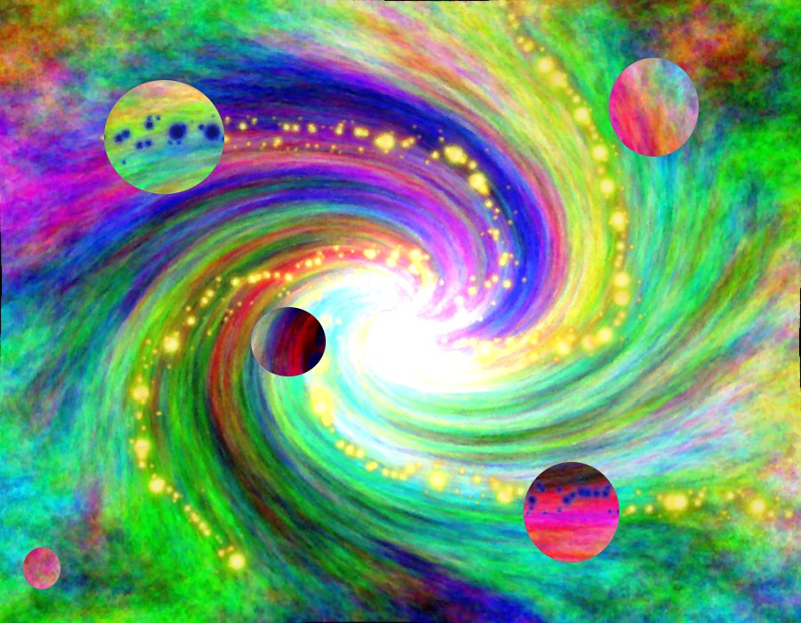
Practical Applications
Company Logos/Signs
Commercials
Digital Paintings
Entertainment

Slide 5
Schedule for the Week
Day1: 3D Printing & Drawing
Day2: Logo Design
Day3: Photography/Photo editing
Day4: Animation/Comics

Slide 6
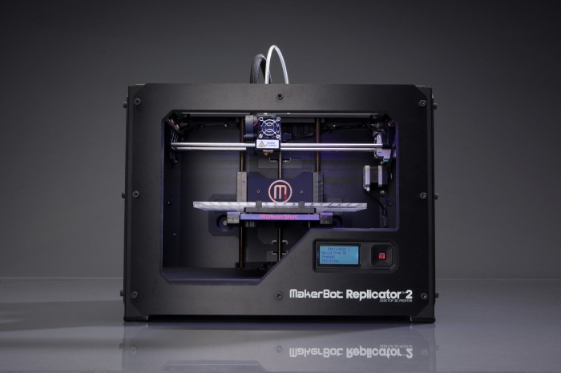
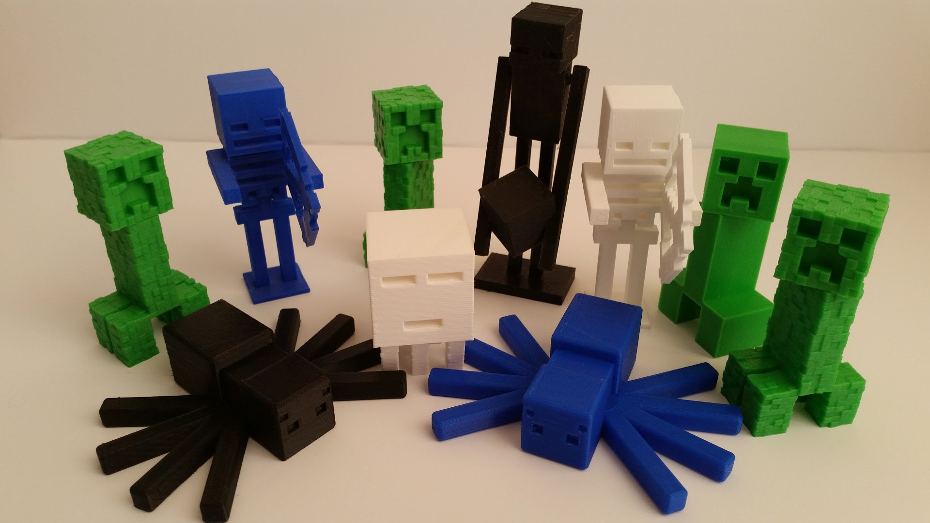
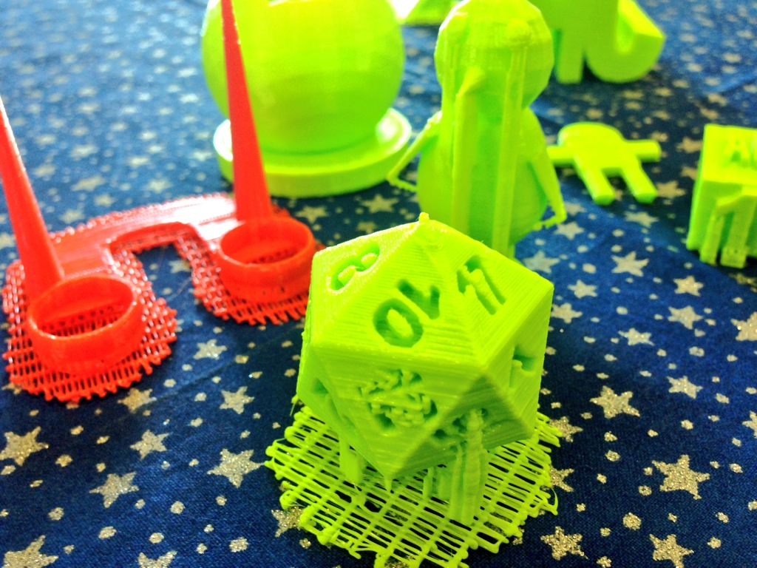
3D Printing
You will design something to 3D print on the apps that we show you!
Be creative!
Check out some of the 3D print ideas around the studio for inspiration!

Slide 7



Logo Design
Logos of companies are usually made online
We’ll use the Assembly app
Make your own!
Or, remake a well known logo!

Slide 8
Logo Design Activity
CONTEST!
Replicate a company’s logo!
This will help you recognize the different designs you can create with this app.
Criteria will be based on how close your logo looks to the company’s actual logo
CREATE A LOGO FOR YOURSELF!
Create a logo the represents you and your interests
be creative; be witty!

Slide 9
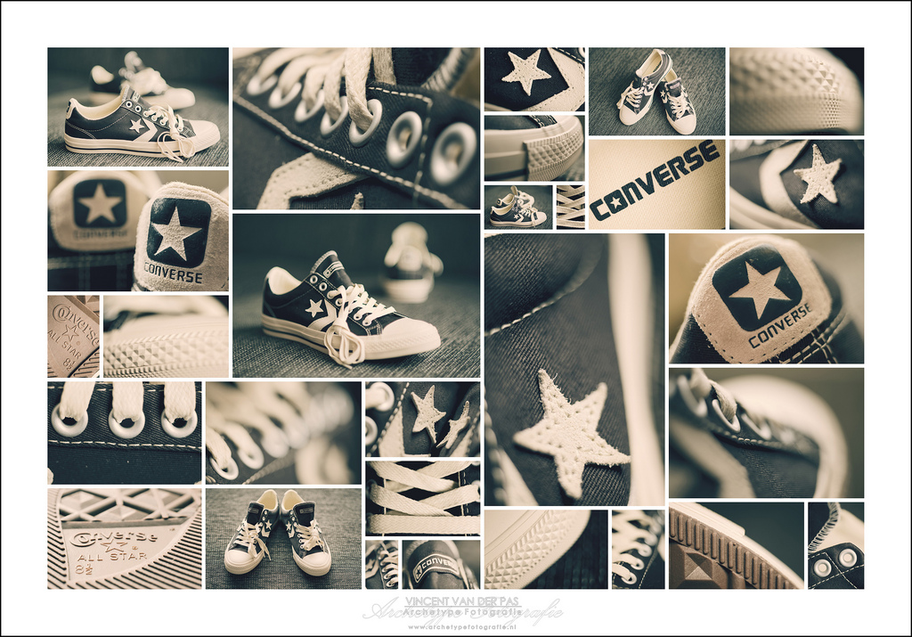

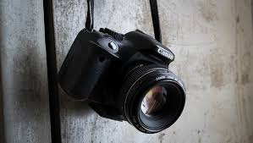
Photography
Take a good photo that you think looks cool
Edit it to your liking!
Create collages!

Slide 10
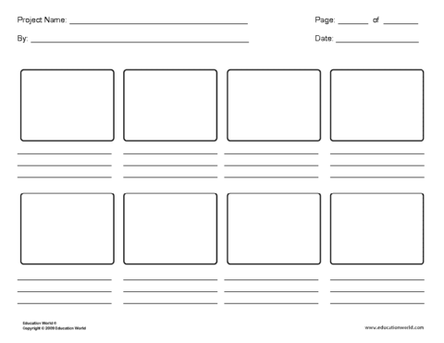
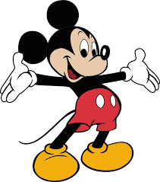
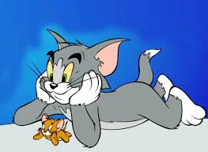
Animation/Digital Comics
Create your own story and bring it to life on the apps we will show you!

Slide 11
Why make a comic strip?
We are bursting with creativity!
making a comic strip is a way to channel our creativity and imagination and capture it in pictures and words

Slide 12
Where do we start?
FIRST choose an overall theme for your comic
Who are the characters? What is the setting?
Find something you are passionate about: do you love superheroes? Monster trucks? Fairies? Ponies?
Choose a subject or character that excites you and create a comic about that!
Start with the Project sheet. Plan out your comic by drawing the scene/characters with names and anything going on in the comic scene

Slide 13
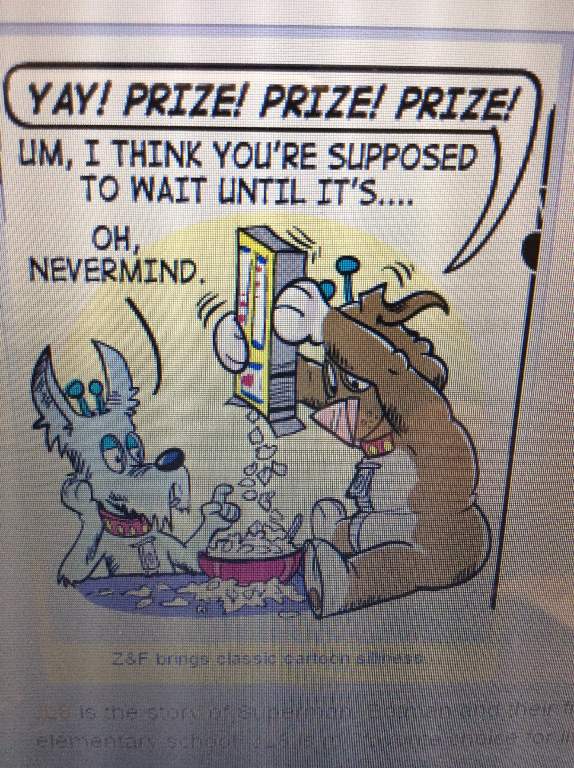
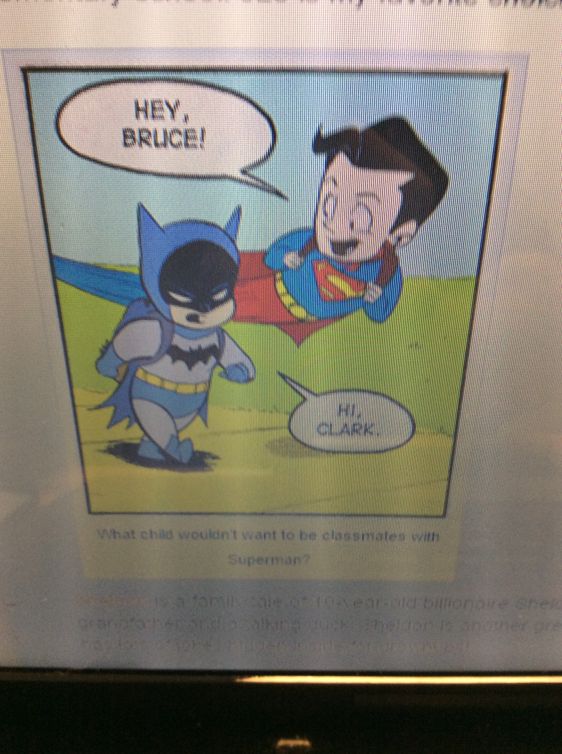
Examples
In Zorphbert and Fred, two aliens disguise themselves as dogs and live among humans
The comic, JL8 is the story of Superman and Batman and their friends as children attending school.

